Slide 1
JJS Enterprise
Your Simple Day To Day News Reader App

Slide 2
Problem Statement
Your grandparents needs a way to be update with their current events because you know how old people are, they love to gossip about what’s wrong with the world today.

Slide 3
Research Highlights
Observations
They want a simplistic app that allows the Users to skim through articles/headlines
Insights
Our app should be as simple as possible but also allow the User to search what they want when they want it

Slide 4
Research Highlights (Cont.
Design Recommendations
ViewPager
RecyclerView
CardViews
Image with Headlines

Slide 5
User Persona - Ceci
-Your average 50 something year old nurse working in the middle of Manhattan
- lives in Queens and spends about an hour and a half in the subway when she has work
- still reads the newspaper
- loves to read about celebrities
- would love a newsreader app if it were easy enough to use

Slide 6
User Persona - Kis
- in his mid 30s
- works in the city
- loves to read Facebook newsfeed
- gets his news from Facebook and the TV
- doesn’t share news that much

Slide 7
Feature Prioritizations
High
Shareable Comment Tutorial | Offline Reading* View Pagers Nav Drawer Table Of Contents Bookmarking
Breaking News Alerts Push Notifications | News* Filter/Search* Landscape/Portrait View Follow/Subscribe RecyclerView
Cost
Low Value High

Slide 8
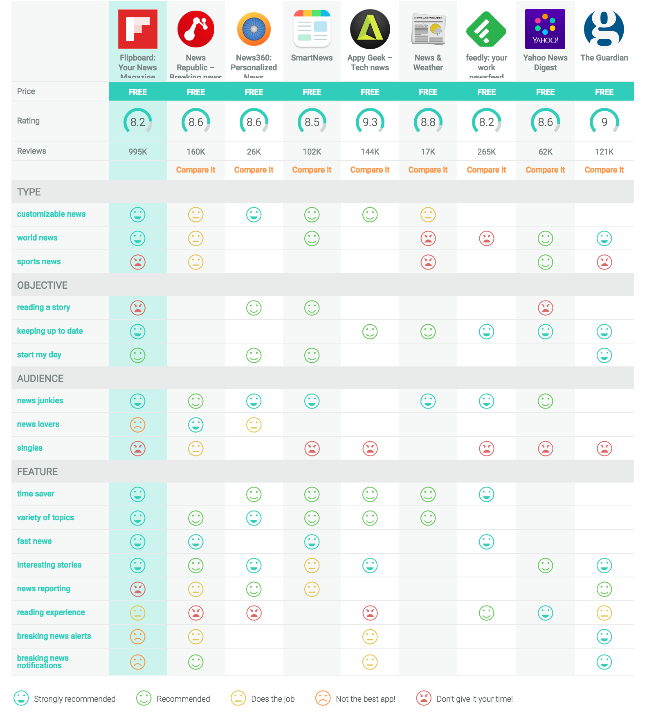
Competitive Analysis

Slide 9
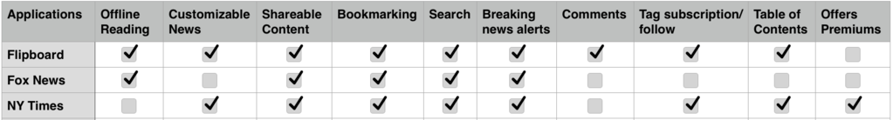
Comparative Analysis

Slide 10
Constraints
Skill
Teammates all have different fortes (i.e. Fragments/Activities)
Time
7 Days time to make a viable working product
Communication
Need better communication skills

